Slide 1


Dactylology Reader
A Web App dedicated to the wordless
Cryptominers
Karthikraj G,CSE
Ela Tejeshwar,CSE
Arjun Rampal,CSE
Gautham Gopi,CSE
Balaji N,CSE
01

Slide 2

PROJECT
ELUCIDATION
Web app that uses Tensorflow.JS to detect real time human hand gestures.
The detected gesture is then converted into text format and display its exact meaning to the user.

Slide 3

FEATURES & UNIQUE SELLING POINTS
This web app helps the people with difficulty in speaking and hearing to interpret and convey their message in the most convenient manner.
It serves as a guide to those who yearn to learn sign language.

Slide 4
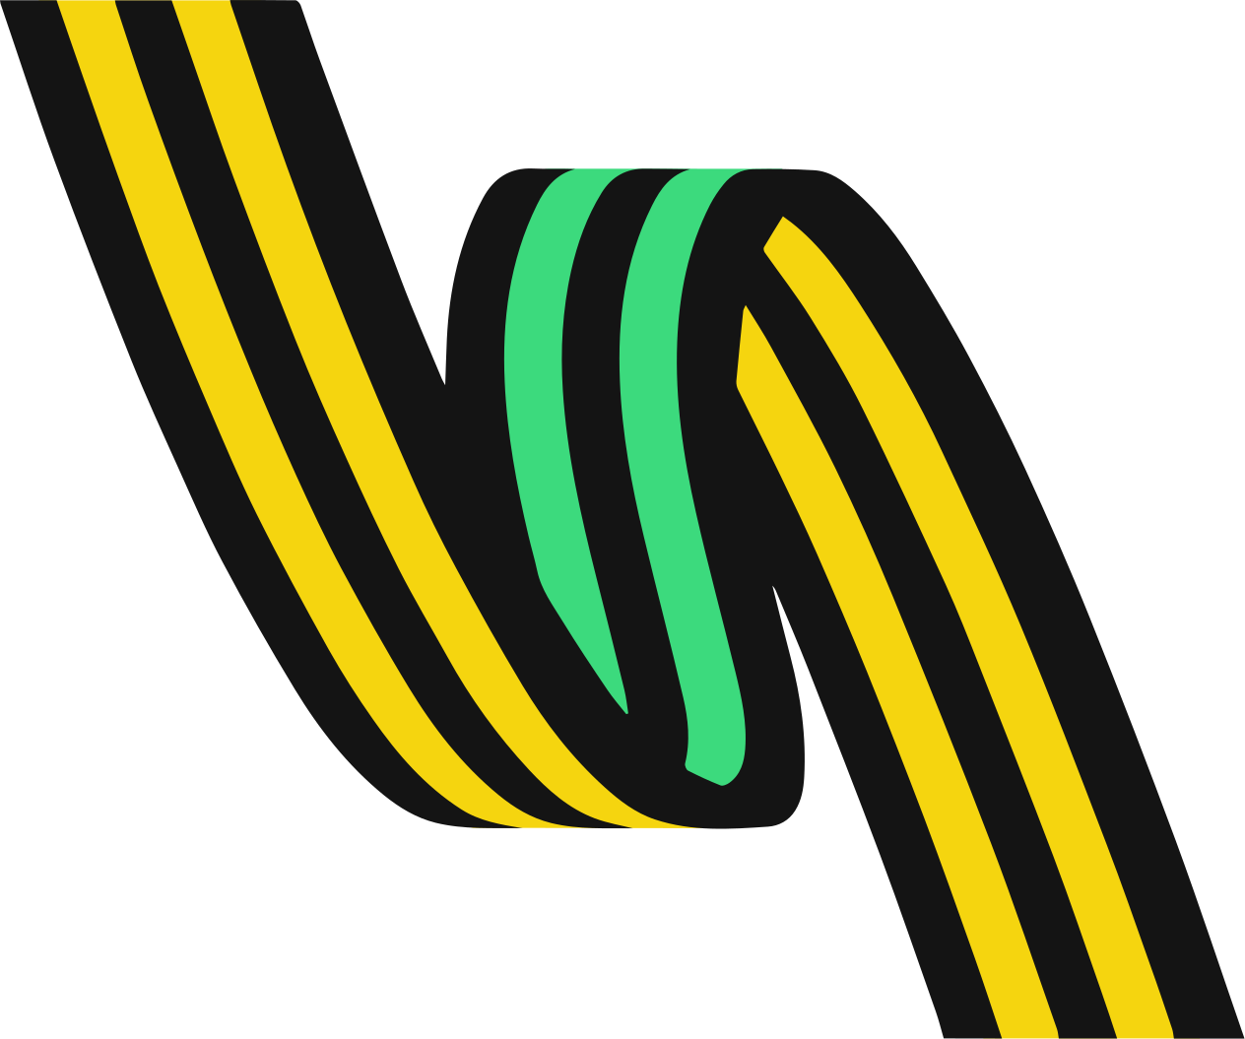




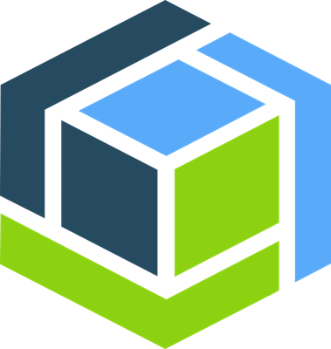
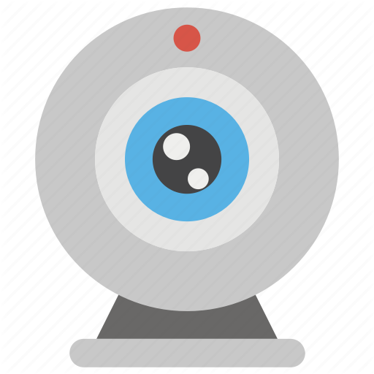
FLOW DIAGRAM
Host the model on Cloud Object Storage
Capture gestures from a webcam for object detection
1
2
3
4
5
Convert the trained Tensorflow model into Tensorflow.JS
Making a standalone front end application using React.JS
Make detections using
Tensorflow.JS

Slide 5
TECH STACK
TensorFlow is an end-to-end open source platform for machine learning. It has a comprehensive, flexible ecosystem of tools, libraries and community resources that lets researchers push the state-of-the-art in ML and developers easily build and deploy ML powered applications
ReactJS is JavaScript library used for building reusable UI components.React is a library for building composable user interfaces. It encourages the creation of reusable UI components, which present data that changes over time.
OpenCV is a cross-platform library using which we can develop real-time computer vision applications. It mainly focuses on image processing, video capture and analysis including features like face detection and object detection.
IBM Cloud Object Storage is a highly scalable cloud storage service, designed for high durability, resiliency and security. Store, manage and access your data via our self-service portal and RESTful APIs. Connect applications directly to Cloud Object Storage use other IBM Cloud Services with your data.

Slide 6
THANK YOU

